Slide 1
Concepts of Evil Explained Through Abu Ghraib Prison Abuse

Slide 2
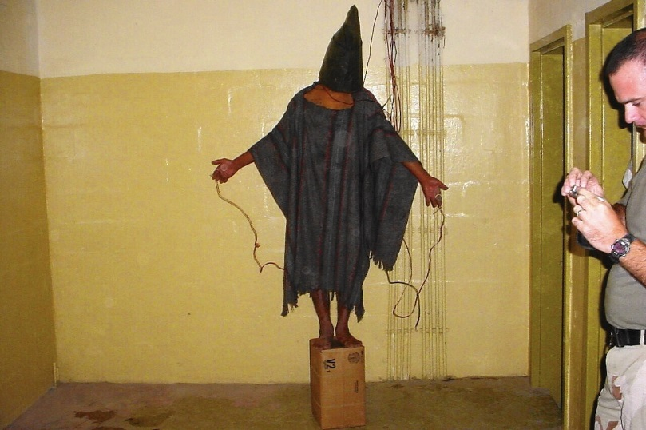
Abu Ghraib: An Introduction
Prisoner abuse:
Physical, psychological and emotional abuse
As various methods of interrogation
E.g. - Feminisation of male prisoners
Soldiers types (and why)
Only females
For scapegoating to avoid political intervention. (Caldwell, 2012, p. 104, cited in Banwell, 2013, pp. 214 – 215)
Example:
Lynndie England humiliation of male prisoner
Notes:
As described in Banwell revision of Caldwell (2012) book, called Fallgirls: Gender and the Framing of Torture at Abu Ghraib, Abu Ghraib was a prison that was originally designed to interrogate Iraqi prisoners in order to obtain vital information. One of these forms of interrogation was a form of torture where the masculinity of male prisoners were taken away from female prisoners.
A form of torture that was deliberately delegated to female soldiers, in order for the prison officials to use as scapegoats, in case if the torture was ever discovered by British or Iraqi government officials, as to avoid scrutiny and avoid political intervention.
However, the torturous (evil) acts escalated and expanded to include people who were not prisoners of war (i.e. – civilians and Muslims), such as the events of Lynndie England and her male prisoner of whom she humiliated through physical restraint and forced to remove clothes whilst other prisoners/soldiers watched (as seen in the picture in the slide I’m about to show you). (Caldwell, 2012, p. 104, cited in Banwell, 2013, pp. 214 – 215).

Slide 3
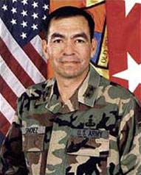
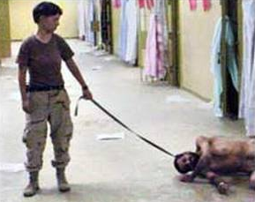
Leibniz VS Descartes: Do Humans Have Free Will To Punish Others?
Do soldiers/prisoners (agents) have free will?
Do soldiers instigate self-protection?
Is punishment or abuse in chain of command evil?
Leibniz:
Soldiers punished prisoners
Soldiers feared their superiors
Soldiers and prisoners lose freedom of will
Soldiers instigate self-protection
Chain of command is evil
Descartes:
Soldiers refuse punishing prisoners
Prisoners refuse to be punished
Soldiers and prisoners had freedom of will
Soldiers don’t need to self-protect
Punishment is evil. Wee (2006, p. 387).
An official in Abu Ghraib incident
Lynndie England (soldier; on the left) with prisoner (on the right)
Notes:
So, I’m attempting to explore how moral discourse explains this concept of evil, through looking at Leibniz and Descartes perspectives on these three questions.
Leibniz argues that soldiers punished prisoners because they were afraid of the harm that would be inflicted onto themselves for disobeying orders from officials. Even though, soldiers committed evil acts, it was in the way that their superiors stripped away their freedom of will was the reason for the evil acts committed. Therefore, Leibniz would postulate that the chain of command is evil, as this follows the principle of sufficient reason in how these evil acts are the will of God to create ‘the best of all possible worlds’, of which agents involved (so prisoners and soldiers) couldn’t do anything other than what they did.
On the other hand, Descartes argues a less appealing alternative to Leibniz argument. This is that soldiers had the freedom of will to chose not to follow orders from their superiors, just as the prisoners had the choice to stand up to their abusers (soldiers). Together, the prisoners and soldiers could have rebelled and over threw the soldiers’ superiors (so instigated mutiny) which wouldn’t need for soldiers to protect themselves from their officials, instead soldiers abused the prisoners and prisoners ‘allowed’ for the soldiers to abuse them. Therefore, Descartes would postulate that the punishment is evil, as the individuals in question could of acted differently but chose not too. Wee (2006, p. 387).
Descartes argument questions whether or not the more popular option accurately explains how the concept of evil presented at Abu Ghraib is represented in moral discourse. This is because Leibniz indirectly suggests that evil should be scapegoated to third parties (i.e. – chain in command) in an attempt for agents to escape responsibility for their actions. Whilst, Descartes believes that evil shouldn’t be out casted as Leibniz (indirectly) suggests, evil should be accepted as an integrative part of society; an area that will be explored further by Danguole.

Slide 4
Functionalism/ Marxism /Durkheim's Anomie and Dereglement on Good and Evil at Abu Ghraib
Functionalism:
"There can be no good without evil"
The evil acts are necessary in society to strengthen morality and recognize good.
Anomie and Dereglement (Mestrovic & Lorenzo, 2008).
Durkheim's theory of anomie is based on the belief that there can be situations in society where pre-existing rules are no longer working regulations so individuals start acting outside what is considered ”normal” to the group. He calls this phenomenon Dérèglement (derangement) which can be seen as ”a rule that is a lack of rule” (Mestrovic & Lorenzo, 2008).
Marxism:
There is no good or evil
Everything serves in favor of ruling class

Slide 5
Evil explained by Theory of Social Construction of Reality (Berger & Luckmann, 1966) and Thomas Theorem (1995)
Social Construction of reality theory argues that each person interprets what they see in a different way, forming an opinion or reaction based on the meaning or value they attach to an object, symbol, person, or interaction (cited in Berger & Luckman, 1966, p.35)
Evil behaviors became legal under the new circumstances of international terrorism.
Solders of Abu Ghraib were agreed upon by authority to use brutal interrogation techniques to obtain valued information from the prisoners.
New reality at Abu Ghraib: prisoners were seen evil because of international terrorism, therefore inhumanity and evil acts were used towards them.

Slide 6
Thomas Theorem (1995)
In a socially constructed reality, when someone defines situation real, it becomes real to his consequences and leads to appropriate behaviour (cited in Merton, 1995, p. 380).
Solders had been acting evil, because the reality was socially constructed to act in a such way by legitimacy and authorization.
The guards shed personal accountability for their actions because were acting under the power of authority (ruling class).

Slide 7
Foucault: Disciplinary/Security Apparatuses
Foucault argues that there are fundamental differences between disciplinary and security apparatuses of power
“…discipline functions to the extent that it isolates a space, that it determines a segment. Discipline concentrates, focuses and encloses. The first action of discipline is in fact to circumscribe a space in which power and mechanisms of its power will function fully without limit.”
“Security apparatuses have the constant tendency to expand; they are centrifugal. New elements are constantly being integrated…Security therefore involves organising, or anyway allowing the development of even wider circuits.”
(Foucault, 1977, cited in, Cation and Zacka, 2010, p.208)

Slide 8
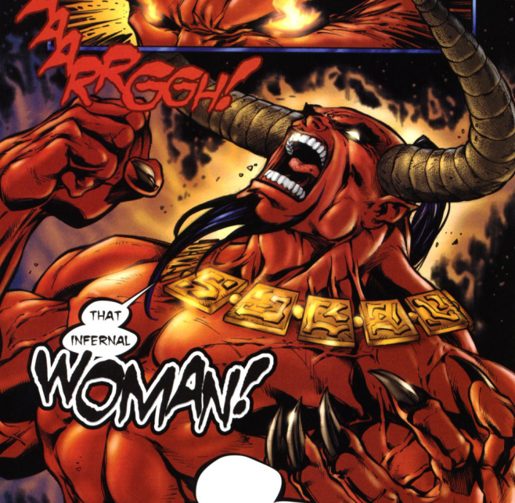
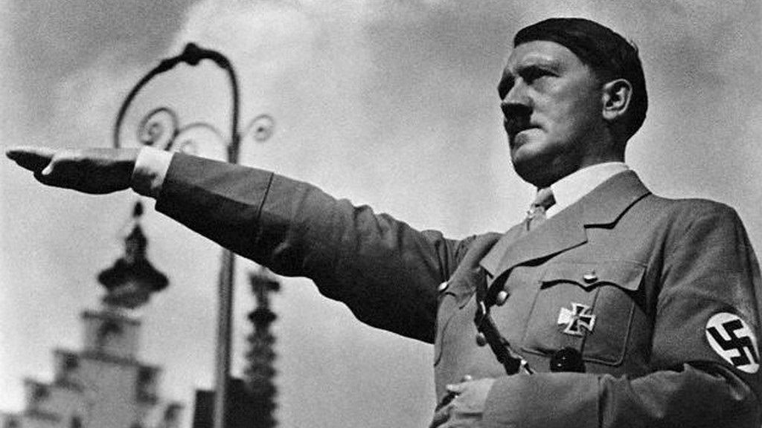
Kant: Transcendent Ethic
Kant’s notion of radical evil
Two concepts: ‘roots’ and ‘exemplary’
“A Kantian or transcendent notion of good and evil informs contemporary rights discourse when it speaks of ‘human rights’ of one sort or another whose violation must be punished by ‘international law’. Ethics in this view is supposedly derived from a priori and anyone who challenges its universality must be ‘backwards’.” (reference)

Slide 9
Moral dilemma, media and propaganda
Kant believes, religion should be an example of the obedience to the moral law. (Internet Encyclopedia of Philosophy)
It can be argued that soldiers in Abu Ghraib were in a moral dilemma:
High trust in the government that exists to secure social order (Gushe, 2014).
After 9/11 the media representation of the USA was that they are "fighting global evil" in the name of freedom. (Dews, 2007, p. 2)
As the media is owned by the people with power, they can use it as a tool to achieve their goals (e.g. to attack Iraq) and also to free themselves of the responsibility of their evil acts.
Kant (1971/1797), Mill (1979/1861) and Ross (1930, 1939) - adequate moral theory should not allow genuine moral dilemmas.
(Stanford Encyclopedia of Philosophy)

Slide 10
Obedience to authority
Evil acts similar to the Abu Ghraib torture would not be able to happen if the lower layers of the power structure are not obedient (see the pyramid - handout).
Zimbardo found similarities between Abu Ghraib prison abuse and:
Stanford Prison Experiment (conforming to group norms)
Milgram's experiment (obedience to authority)
Ash’s experiment (conformity)
(Zimbardo, 2007, pp. 258-350)
In Abu Ghraib, soldiers were strongly affected by external situations. However as Descartes said, they have free will.

Slide 11
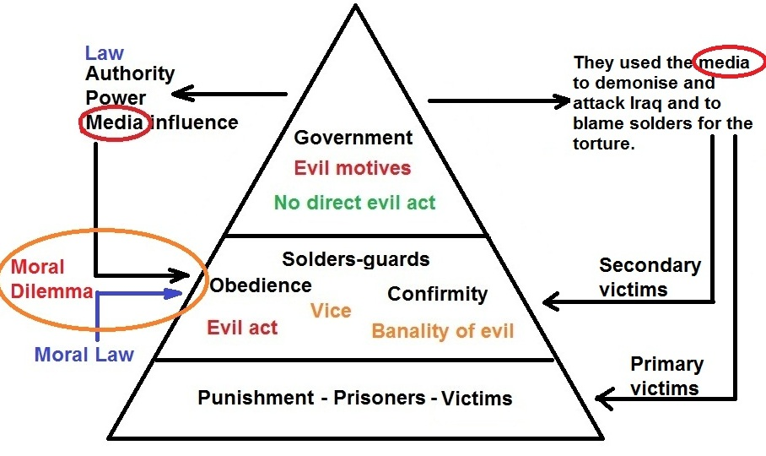
Concepts of Evil Explained Through Abu Ghraib Prison Abuse

Slide 12
References:
Banwell, S. (2013) 'Review of Fall girls: Gender and the framing of torture at Abu Ghraib', Crime, Media, Culture, 9(2), pp. 214-216, DOI: 2048/10.1177/1741659012466337.
Berger, L. & Luckmann, T. (1966) The Social Construction of Reality. Available at: http://perflensburg.se/Berger%20social-construction-of-reality.pdf Accessed: 30 April 2016.
Caton., S. C. (2010), 'Abu Ghraib and the Problem of Evil' in Lambek, M. (ed.) Ordinary Ethics: Anthropology, Language and Action. New York: Fordham University Press, pp. 165 - 184.
Caton., S. C., and Zacka., B., (2010) 'Abu Ghraib, the Security Apparatus, and the Performativity of Power', American Ethnologist, 37(2), pp. 203 - 211, Available at: http://isites.harvard.edu/fs/docs/icb.topic1195064.files/12.%20Caton%20Zacka%20Abu%20Ghraib%20the%20Security%20Apparatus...pdf (Accessed: 05/05/2016)
Eysenck, M., W. (2009) Fundamentals of Psychology. Hove: Psychology Press.
Gushee, D. (2014) In the fray: Contesting Christian Public Ethics, 1994-2013, Oregon: Cascade Books.
Hanson E. M. (2016) "Immanuel Kant: Radical Evil" in Internet Encyclopedia of Philosophy [Online]. Available at: http://www.iep.utm.edu/rad-evil/ (Accessed: 30 April 2016).
McConnell, T. (2002) "Moral Dilemmas" in Stanford Encyclopedia of Philosophy [Online]. Available at: Plato.stanford.edu. Available at: http://plato.stanford.edu/entries/moral-dilemmas/ (Accessed: 30 April 2016).
Merton, K. R. (1995) The Thomas Theorem and The Matthew Effect? Available at: https://www.csudh.edu/dearhabermas/thomastheorem.pdf Accessed: 30 April 2016.
Mestrovic, S. G. & Lorenzo R. (2008) Durkheim's Concept of Anomie and the Abuse at Abu Ghraib, Journal of Classical Sociology, 8(2), pp. 179-207. Accessed: 6 May 2016
Wee, C. (2006) ‘Descartes And Leibniz On Human Free-Will And The Ability To Do Otherwise’, Canadian Journal Of Philosophy, 36(3), pp. 387 – 414, DOI: 10.1353/cjp.2006.0020.
Winthrop (2013) The Three Main Sociological Perspectives. Available at: http://faculty.winthrop.edu/solomonj/FALL%202013/SOCL_ANTH%20302/The%20Three%20Main%20Sociological%20Perspectives.pdf Accessed: 4 May 2016.
Zimbardo, F. (2007) The Lucifer effect: Understanding how good people turn evil, New York: Random House.

